Slide 1
Employee Attendance & WFH Trend Analysis
CH. Ajay Sai Phaneendra Reddy

Slide 2

Index
Objectives
KPI 1 : Present Percentage & Day of the week
KPI 2 : Work From Home (WFH) Percentage & Day of the week
KPI 3 : Sick Leave(SL) Percentage & Day of the week
KPI 4 : Present Percentage Trend
KPI 5 : Work From Home Trend
KPI 6 : Sick Leave Trend
KPI 7 : Tables Of the Percentages Of Employees
Power BI Dashboard
Summary

Slide 3
Objectives
Working Preference of Employees?
Find the WFH & SL percentages?

Slide 4
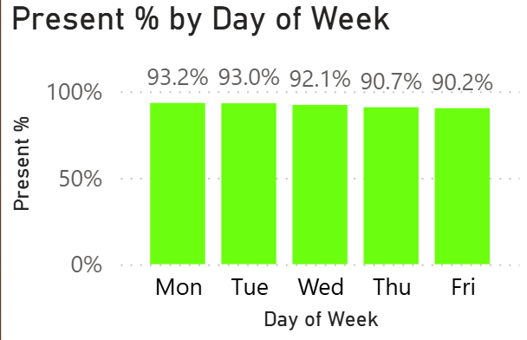
KPI 1 : Present Percentage & Day Of The Week
Observation:
Overall Present % is 91.9%
Monday & Tuesday shows the Highest attendance
Friday has relatively lower presence
Conclusion:
Plan team activities & client meetings on Mon-Tue
Avoid critical meetings on Friday
91.9%
Present %

Slide 5
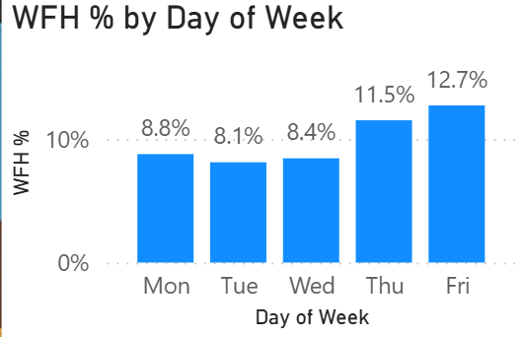
KPI 2 : Work From Home (WFH) Percentage & Day of the week
Observation:
Overall WFH percentage is 9.9%.
Friday shows the Highest WFH percent.
Tuesday shows the lowest WFH percent.
Conclusion:
Employees prefer more WFH on Thursday & Friday.
As the earlier Slide conclusions the present percent is more strong on (Mon-Wed)
9.9%
WFH %

Slide 6
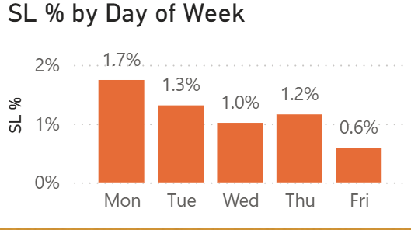
KPI 3 : Sick Leave(SL) Percentage & Day of the week
Observation:
Overall SL percentage is 1.2%.
It is showing decline trend from Mon-Fri
Fridays shows the lowest WFH percent.
Conclusion:
SL% is decreasing as the week progresses.
Focus on some corrective actions on (Mon-Wed)
It can reduce the overall SL%
1.2%
SL %

Slide 7
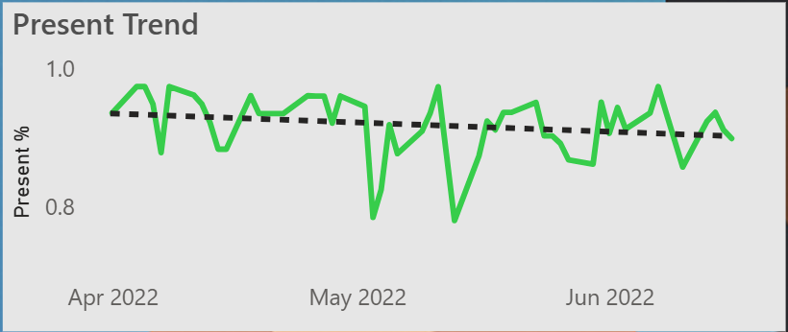
KPI 4 : Present Percentage Trend
Observation:
Overall Trend is going slightly downward movement.
Sharp downward trend are Observed in mid- May.
It shows relative stability during June.
Conclusion:
The trend line indicates a mild decline not a significant drop.
Only on mid-May is influencing because of summer factor.
Apart of minor fluctuations the trend remains stable.

Slide 8
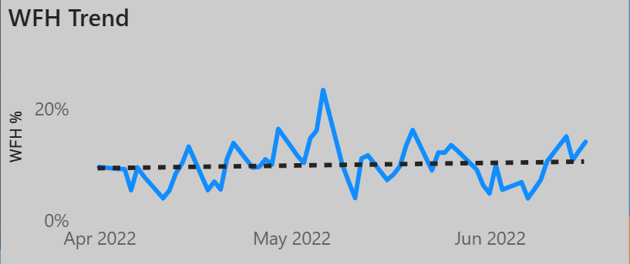
KPI 5 : Work From Home Trend
Observation:
WFH % shows frequent fluctuations throughout the period.
Highest % was showing in May.
WFH levels shows relatively stable toward June
Conclusion:
The overall trend remains increasing movement.
Short-term dips indicate the Seasonal factors (or) variations.
At the end of the June employees are more interested to do WFH .

Slide 9
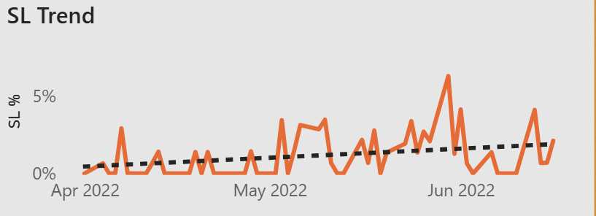
KPI 6 : Sick Leave Trend
Observation:
SL % shows intermittent fluctuations throughout the period.
Higher % is observed during May-June.
Occasional short-term spikes are visible
Conclusion:
The overall trend shows upward.
High increasing in the May-June and again it consists of seasonal factors.

Slide 10
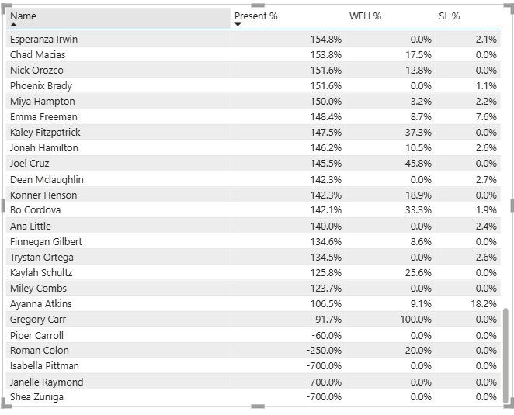
KPI 7 : Tables Of Percentages Of Employees

Slide 11
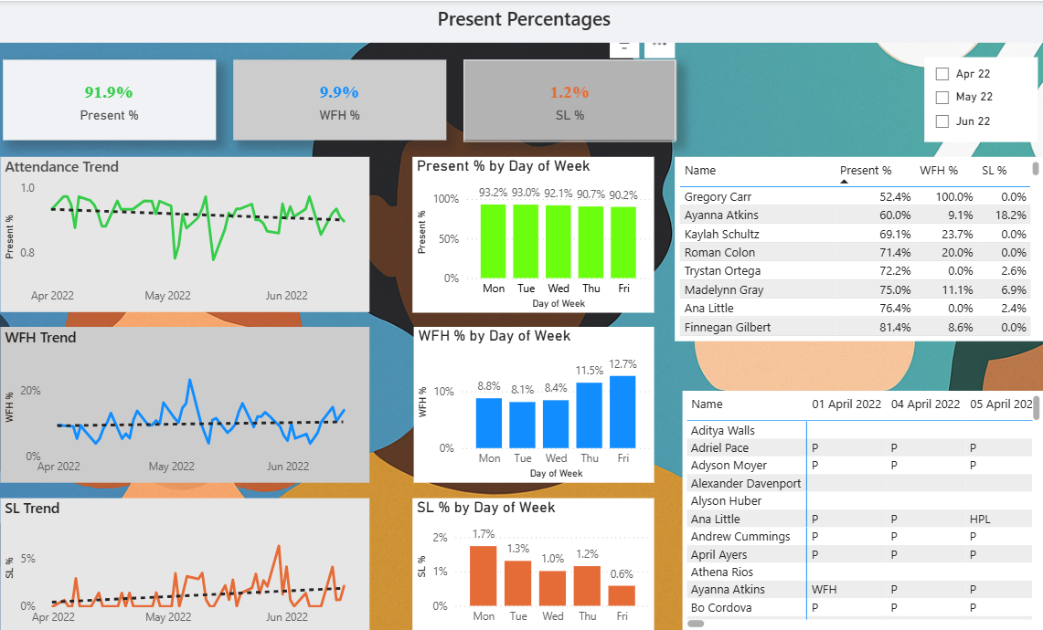
Power BI Dashboard

Slide 12
Summary
Average Presence is 91.9%
WFH is limited 9.9%
Monday & Tuesday shows the highest Preference.
WFH Preference increases towards the end of the week.
Fridays shows lowest present percent.
Plan key meetings , activities early in the week (Mon-Tue).
Flexible work for Thursday – Friday because lower presence in the office.

Slide 13


